Slide 1


Slide 2
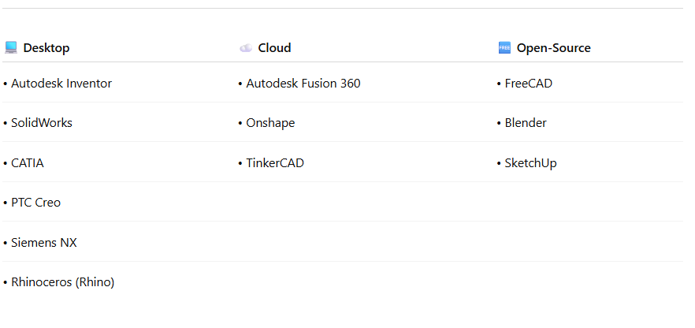
Available CAD Solutions

Slide 3

Learning Fusion 360 From Scratch: A Beginner's Guide

Slide 4
Getting Set Up - Fusion 360
Fusion 360 Accounts
Open Fusion 360 desktop version and login with your school email

Slide 5
Safety Brief
No shop tools today—avoid sharp pencils
Keep workspace tidy (5S: Sort, Set in order)
Avoid kicking wires under the desk
Report any technical issues to instructor

Slide 6
Fusion 360 Interface Tour
Launch Screen:
Overview: Welcome screen with recent files and new project options
Action: Click "New Design from Scratch" to start
Main Workspace:
System Tools (File menu, save, undo/redo)
Canvas: 3D modeling area (center) where sketches and models appear
Toolbar:
Top level tabs (e.g., Solid, Surface, Mesh)
Secondary level groups (e.g., Create, Modify, Constraints)
Tools (e.g., Line, Rectangle, Circle, and contents of dropdown)
Browser: Left panel showing design history, bodies, and components

Slide 7
Fusion 360 Interface Tour
Navigation Tools:
ViewCube: Top-right corner to rotate view (click faces or edges)
Orbit/Pan/Zoom: Middle mouse button or toolbar icons for navigation
Tip: Hold Shift + middle mouse for orbit
Timeline:
Bottom area tracking design steps (editable history)
Use: Click steps to revisit or edit
Quick Tips:
Hover over icons for tooltips
Use F5–F8 for view presets (e.g., F5 for top view)
Ask for help if lost!

Slide 8
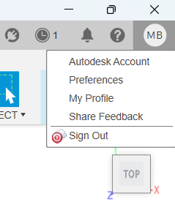
Fusion 360 Preferences
Click on your account settings icon, and select preferences
Reverse Zoom Direction if desired
Change Pan, Zoom, Orbit shortcuts if desired

Slide 9

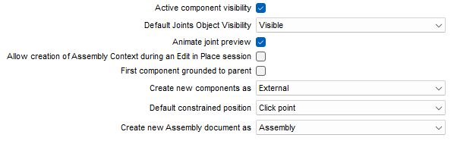
Fusion 360 Preferences

Slide 10
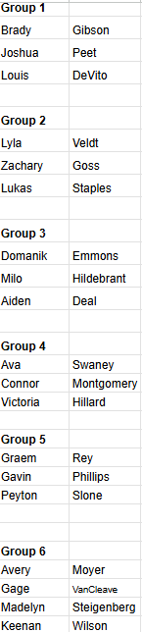

Slide 11
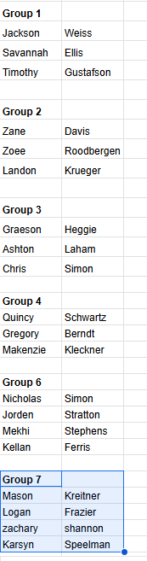

Slide 12
Guide to Making Constrained Sketches
What Are Constrained Sketches?
Sketches where geometry is fully defined (black lines in Fusion 360)
Prevents unwanted changes with parametric editing
Why It Matters:
Ensures accuracy in engineering designs
Ties to EDP "Plan" step (precise planning)

Slide 13
Steps to Create Constrained Sketches
Step 1: Start a New Sketch
Open Fusion 360 > Create > Sketch
Select a plane (e.g., XY plane)
Step 2: Draw Basic Shapes
Use tools: Line, Rectangle, Circle
Step 3: Apply Geometric Constraints
Horizontal/Vertical: Align lines
Parallel/Perpendicular: Match angles
Tangent: Connect curves to lines
Equal: Match lengths or radii
Tip: Right-click to add constraints

Slide 14
Steps to Create Constrained Sketches
Step 4: Add Dimensions
Click Dimension tool
Set lengths, angles, or radii (e.g., 50 mm)
Edit to test parametric changes
Step 5: Verify Full Constraint
Look for black lines (fully defined)
Blue lines indicate under-constrained areas

Slide 15
Example: Draw a rectangle with mounting holes for a cover plate
Example: Draw a rectangle with mounting holes for a cover plate
Open new sketch
Draw a rectangle
Add dimensions during draw or add them after
Start rectangle at origin to constrain to origin
Select rectangle tool again and change line type to construction
Dimension each line from the outer rectangle
Cntrl + Z until dimensions and inner rectangle are gone
Select Offset Tool
Create offset from first rectangle of -10mm

Slide 16
Example: Draw a rectangle with mounting holes for a cover plate
Place circle on one corner of inner rectangle, add dimension and hit enter
Place circle on second corner. Use equal constraint to constrain size to other circle
Cntrl + Z until only first circle remains
Create > Rectangular Pattern
Select circle, select line to indicate direction
Enter distance (extent) and quantity (total including original)
Press OK
Repeat to make two more circles
Cntrl + Z until only two circles remain
Select line tool, select construction type
Hover over midpoint of inner rectangle and create a centerline
Select mirror tool, select circles, define mirror line

Slide 17
Example: Draw a rectangle with mounting holes for a cover plate
Create a circle inside each corner of main rectangle w/o touching lines
Create tangent constraint for each circle to each line of the corners
Dimension each circle to 2mm or use equal constraint
Use trim tool to trim corner off and inside of circle
Cntrl + Z until circles are gone. Count steps
Open filet tool, select first corner, enter dimension (2mm), add remaining corners, hit enter

Slide 18
Tutorial Videos
Fusion 360 in 30 Days Video Tutorial Series
Day 1, Lego Brick
Day 2, Soda Bottle; (Image is in Google Classroom, Unit 2; or download it from the comments section of the video)
Day 3, Paperclip
Day 4, Square Bottle

Slide 19
Ultimaker Cura
https://www.youtube.com/watch?v=7lJmkTSoWLc

Slide 20
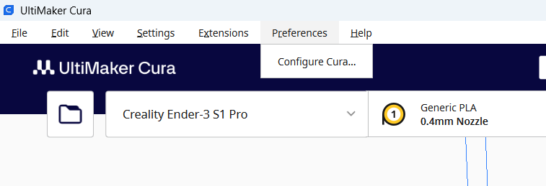
Configuring Cura

Slide 21
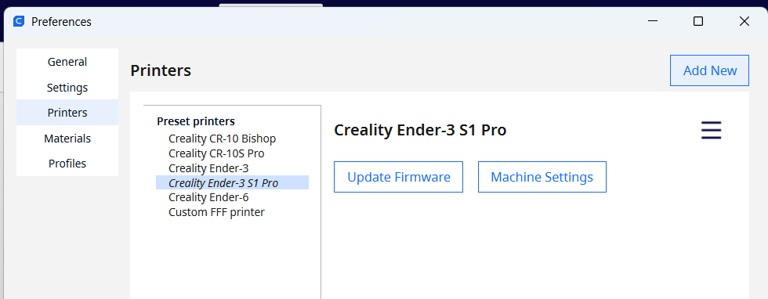
Configuring Cura

Slide 22
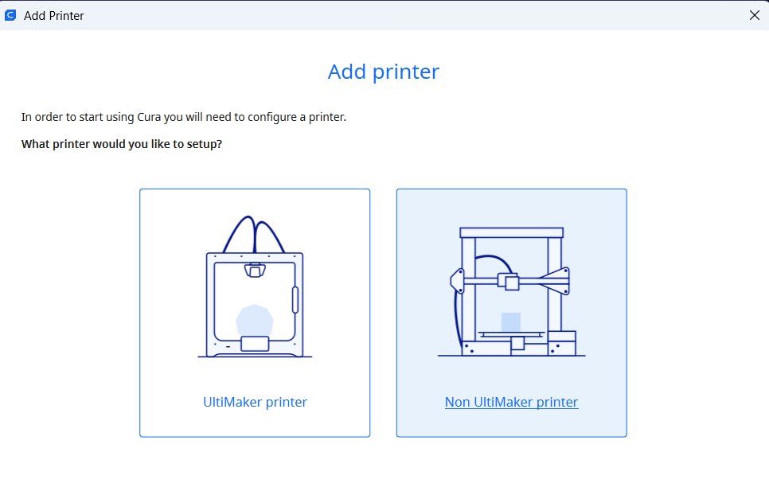
Configuring Cura
1
2

Slide 23
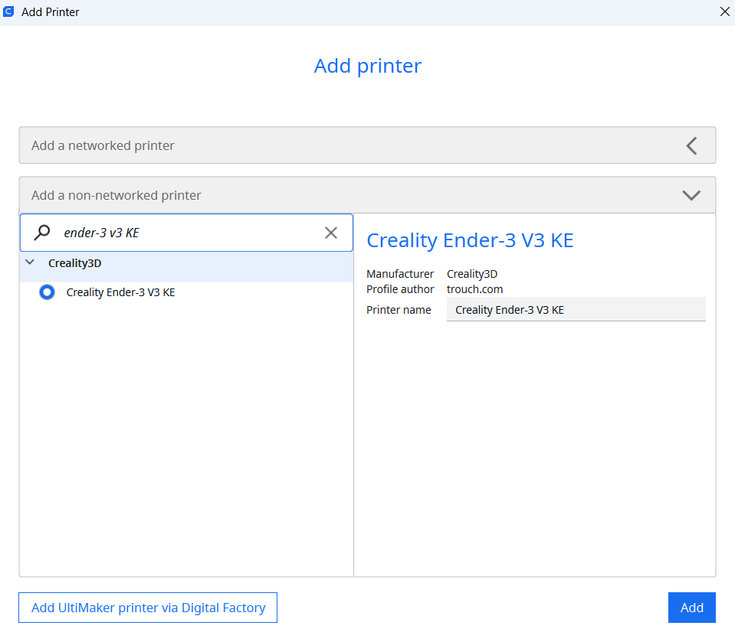

Configuring Cura

Slide 24
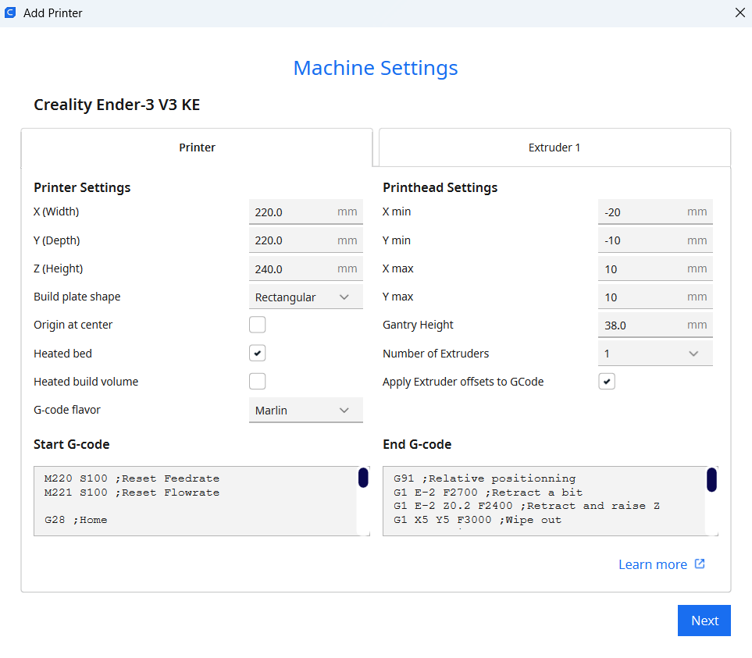
Configuring Cura

Slide 25
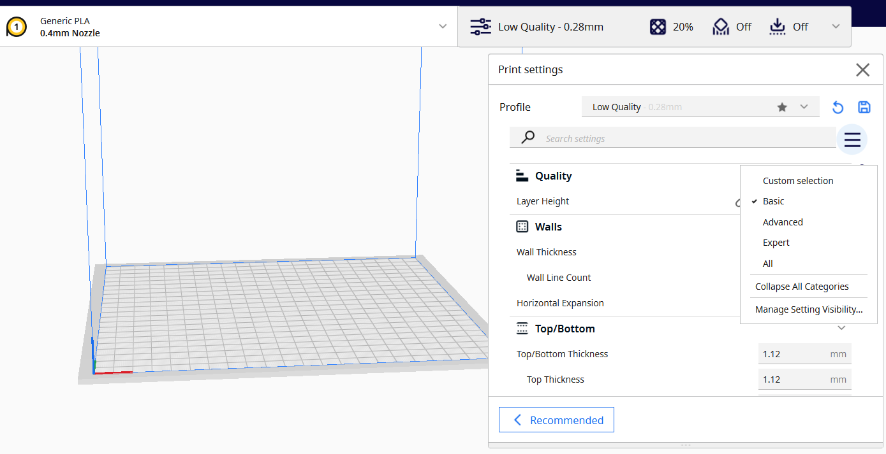
Configuring Cura - Select Basic Settings Visibility

Slide 26
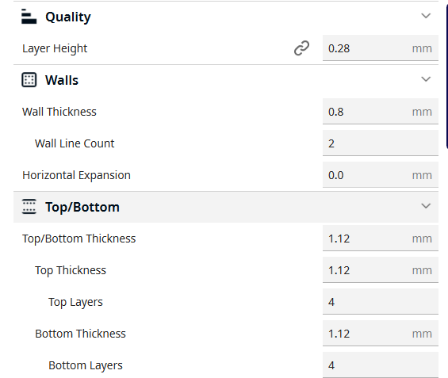
Configuring Cura

Slide 27
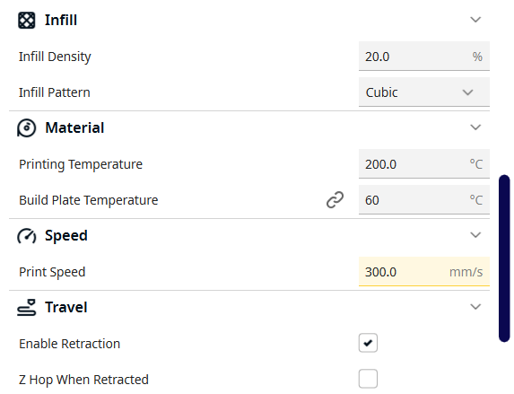
Configuring Cura

Slide 28
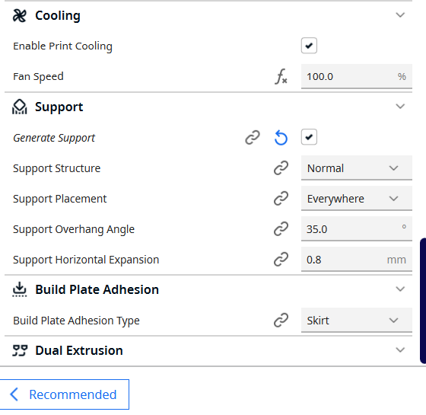
Configuring Cura

Slide 29
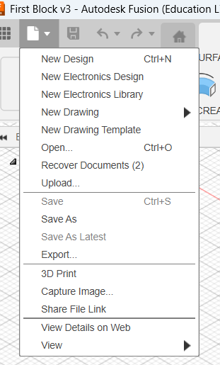
Export Model from Fusion 360 for 3D Printing
Select 3D Print from the File menu

Slide 30
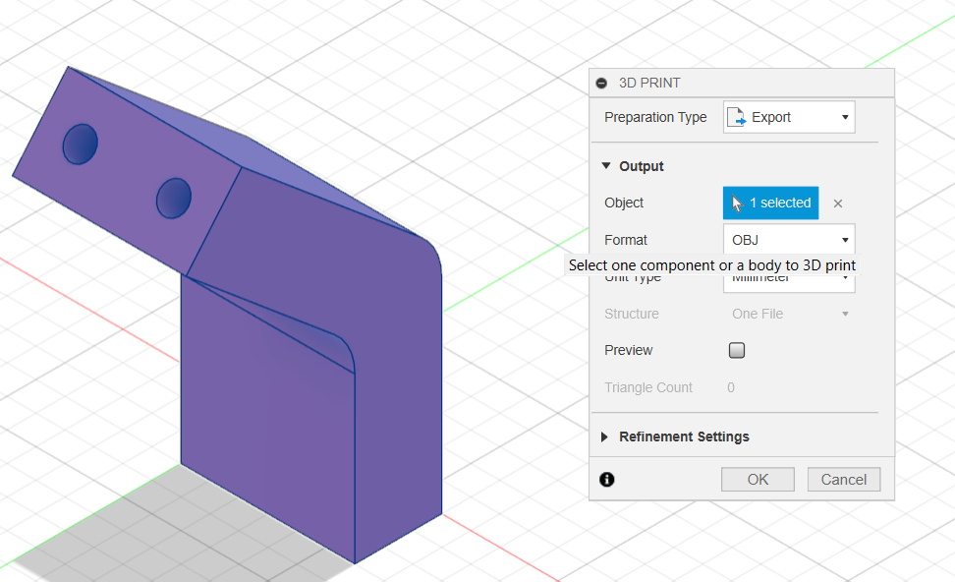
Export Model from Fusion 360 for 3D Printing
Click on your model to select it.
Ensure preparation type is set to Export.
Select OBJ format.
Click OK. Set filename and path in next window.
2
1
3
4

Slide 31
STL vs OBJ File Format
STL (Standard Tessellation Language) files store a 3D object's surface geometry using a mesh of triangles, making them ideal for simple 3D printing but lacking color or texture data.
OBJ (Wavefront Object) files are more versatile, supporting various polygon shapes, and can also include color, texture, and material information, though this requires a separate MTL file. The best format depends on the application: use STL for basic 3D printing, and OBJ for rendering, detailed geometry, or models with color and texture.

Slide 32
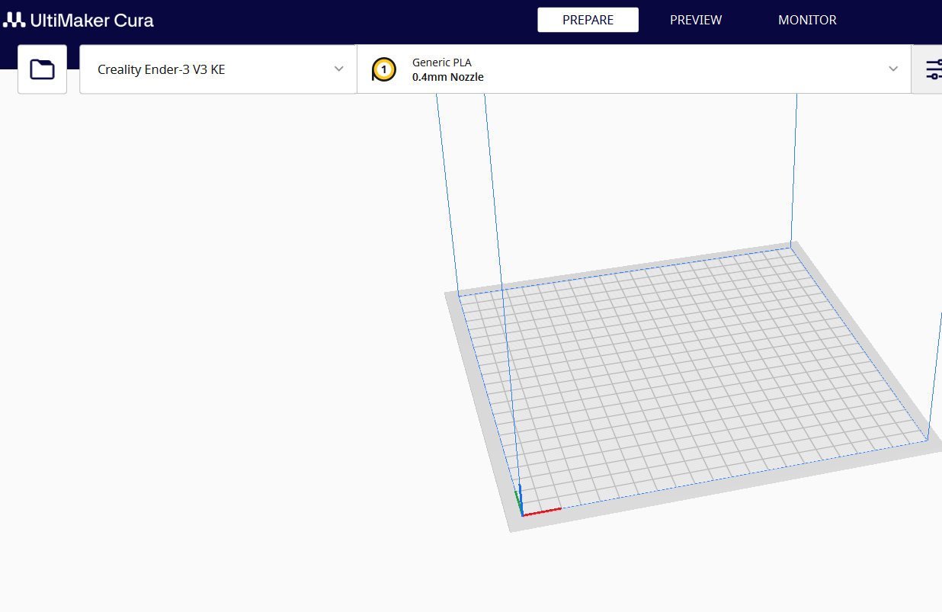
Importing File to Cura
1
Click on the file folder icon.
Select your file.

Slide 33
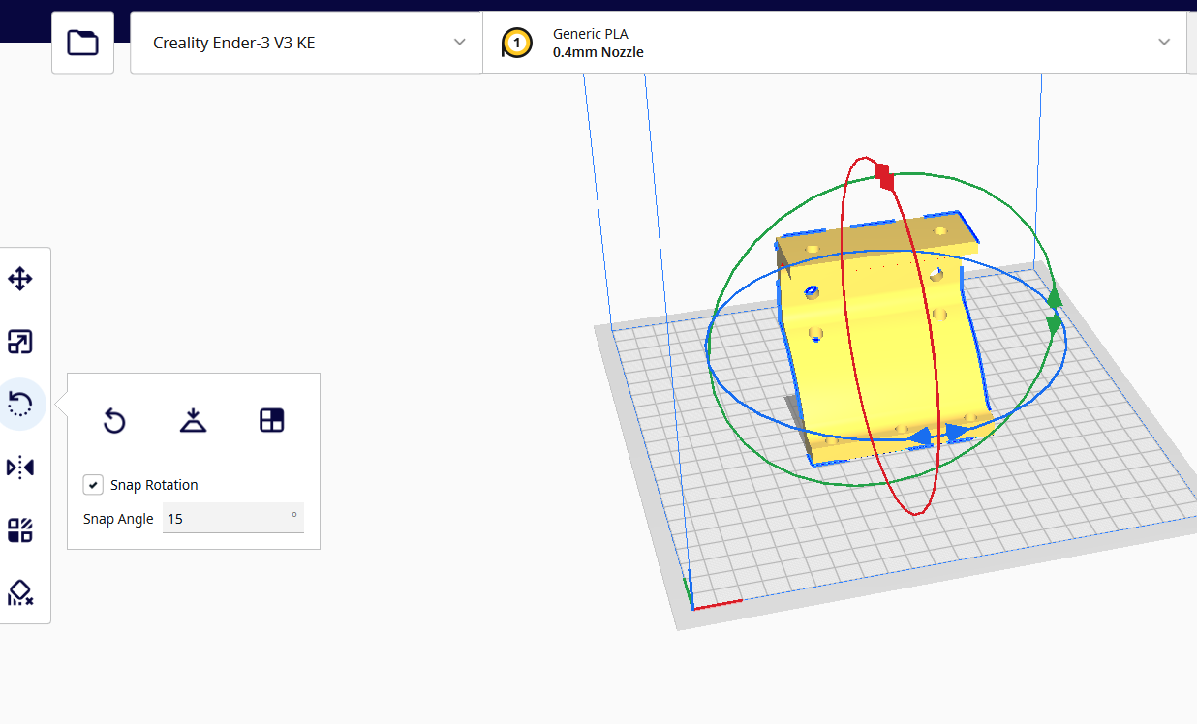
Slicing Parts for Printing in Ultimaker Cura
Use the toolbar on the left to activate tools to manipulate your model. Orient the model to optimize print strength, build plate adhesion, and to reduce the need for supports.

Slide 34
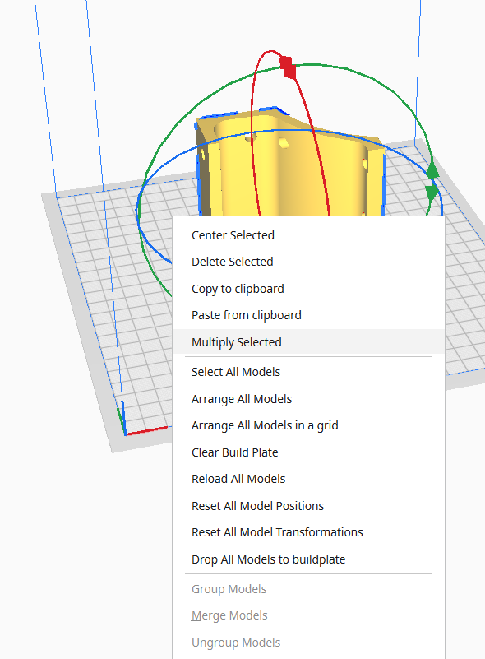
Slicing Parts for Printing in Ultimaker Cura
Right click on the build plate to access other options.

Slide 35
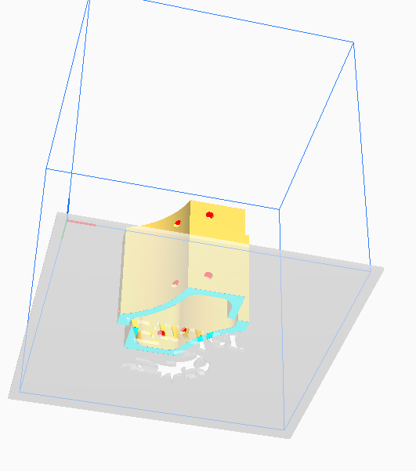
Slicing Parts for Printing in Ultimaker Cura
Right click and hold to rotate the model to examine all aspects. Ensure the surface touching the build plate is cyan. Red parts indicate areas that may require supports.

Slide 36
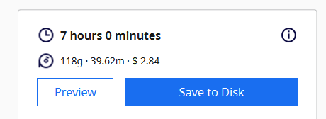
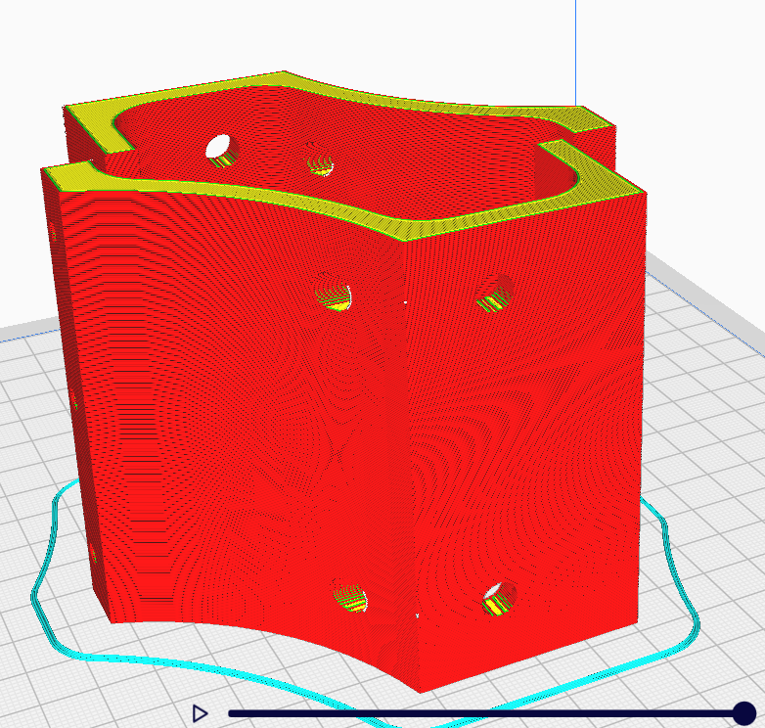
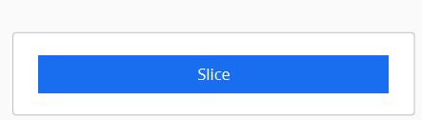
Slicing Parts for Printing in Ultimaker Cura
Slice the part and click on the preview button to examine the sliced part. Notice time and material estimates

Slide 37
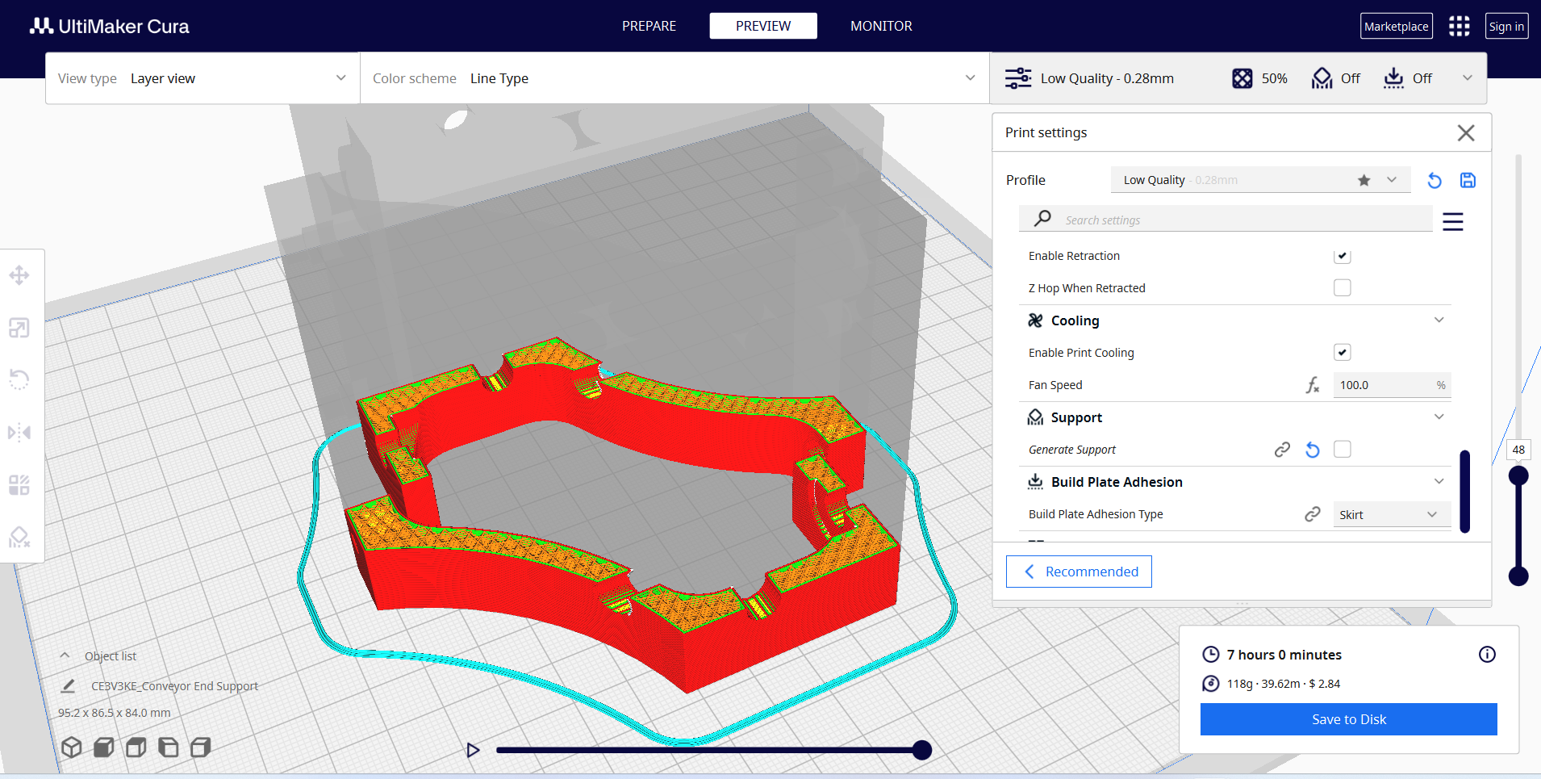
Slicing Parts for Printing in Ultimaker Cura
Use sliders on bottom and right slide to examine layers.

Slide 38
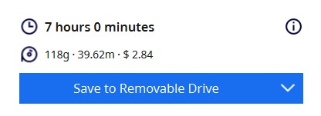
Slicing Parts for Printing in Ultimaker Cura
Insert thumb drive into your computer. “Save to Disk” changes to “Save to Removable Drive” after a moment. Click to save and remove your drive.

Slide 39
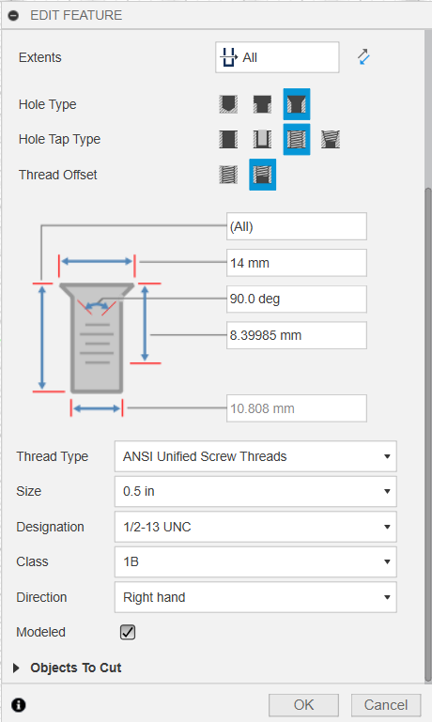
Tutorial Videos Week of 9-22-25
Fusion 360 in 30 Days Video Tutorial Series
Monday: Day 6, Hex Nut
Tuesday: 3D Print ½” Hex Nut
Wednesday: Day 7, Bicycle Grip
Thursday: Day 8, Door Stop, Learning Check
Friday: Shop/Classroom 5S

Slide 40
Tutorial Videos Week of 9-29-25
Fusion 360 in 30 Days Video Tutorial Series
Monday: Day 9, Light Bulb
Tuesday: Day 10, Phone Case
Wednesday: Day 11, Dog Bowl
Thursday: Day 13, Components and Assembly Structure

Slide 41
